Slide 1

Creating R packages on GitHub: a bodgers guide Luke Pilling 2023.01.26
A ‘bodged’ job
a job done of necessity using whatever tools and materials come to hand and which, whilst not necessarily elegant, is nevertheless serviceable

Slide 2

What this talk is not
Intro to R
Intro to making functions in R
-- Assumed you know this already or want to learn separately
Intro to GitHub generally
-- Assumed you know what it is, have an account, etc.
Comprehensive guide to making R packages
-- Instead refer to “R packages” by Hadley Wickham and Jenny Bryan. https://r-pkgs.org/

Slide 3
What I did
I kept copying and pasting bits of useful code from one script to another. Sometimes hard to find, hard to version control, hard(?) to share
So!
I put some of them into functions
I put these functions into a package
I put the package on GitHub
I can now easily load/call/share the useful functions
** Disclaimer: there are loads of great internet resources/tutorials to do this well – this is a “bodge”

Slide 4

What I used to do it
Work laptop (Windows 10)
R v4.2.1
RStudio 2022.12.0 Build 353 << Not required but so useful
R package `devtools`
GitHub Desktop (for Windows)
Of course, all easy to do in a Unix environment if you prefer

Slide 5
R packages are actually really simple
At their most basic, they contain:
2 text files
A description of the package
The names of the functions included
2 directories
The actual R scripts
The associated ‘help’ packages for each function
Package
| DESCRIPTION
| NAMESPACE
|
└───R
| | script.R
|
└─── man
| | script.Rd

Slide 6
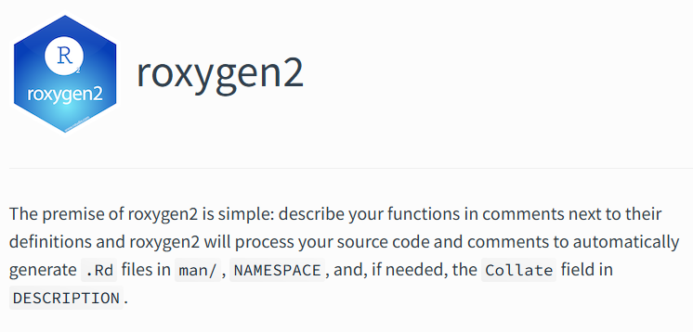
I said I used `devtools` … under the bonnet this relies on `roxygen2`
https://roxygen2.r-lib.org/

Slide 7
R packages are actually really simple
At their most basic, they contain:
2 text files
A description of the package
The names of the functions included
2 directories
The actual R scripts
The associated ‘help’ packages for each function
Package
| DESCRIPTION
| NAMESPACE
|
└───R
| | script.R
|
└─── man
| | script.Rd

Slide 8
R packages are actually really simple
At their most basic, they contain:
2 text files
A description of the package
The names of the functions included
2 directories
The actual R scripts
The associated ‘help’ packages for each function
Package
| DESCRIPTION
| NAMESPACE
|
└───R
| | script.R
|
└─── man
| | script.Rd
`roxygen2` does these bits for us!

Slide 9
R packages are actually really simple
At their most basic, they contain:
2 text files
A description of the package
The names of the functions included
2 directories
The actual R scripts
The associated ‘help’ packages for each function
Package
| DESCRIPTION
| NAMESPACE
|
└───R
| | script.R
|
└─── man
| | script.Rd
We only need to do these bits
** for our minimum functional R package…

Slide 10
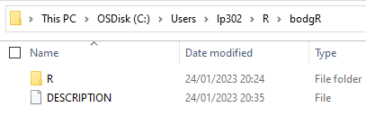
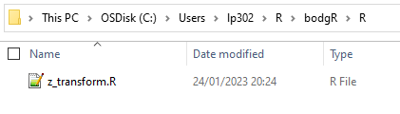
So let’s create a new R package: `bodgR`

Slide 11
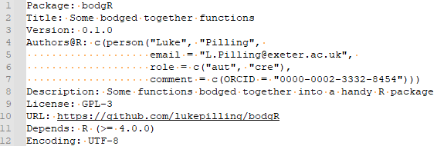
The DESCRIPTION file contains important stuff
The actual package name, title, and description
The version (important for major/minor updates)
Dependencies: e.g., if you rely on the most recent `dplyr` CRAN release 1.0.10 this needs to be listed:
Depends: R (>= 4.0.0), dplyr (>= 1.0.10)

Slide 12

DESCRIPTION file done

Slide 13
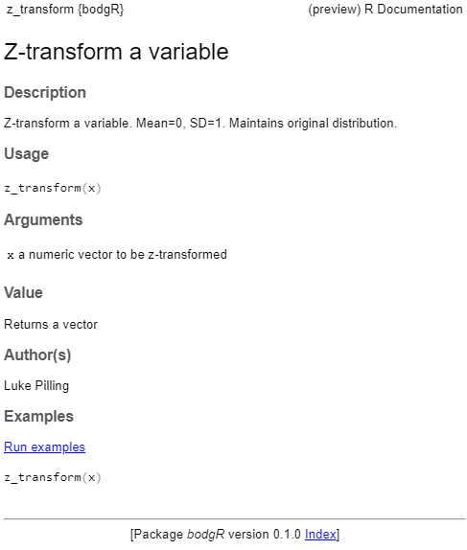
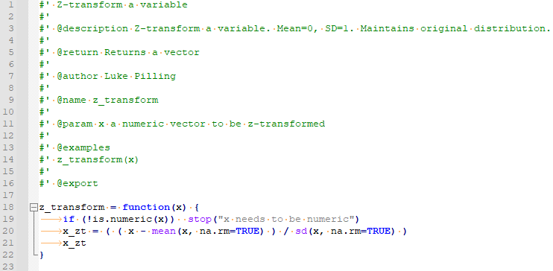
The R script contains comments that become the `help`
See the `roxygen2` docs for details
https://roxygen2.r-lib.org/

Slide 14
DESCRIPTION file done. R script/function done.

Slide 15
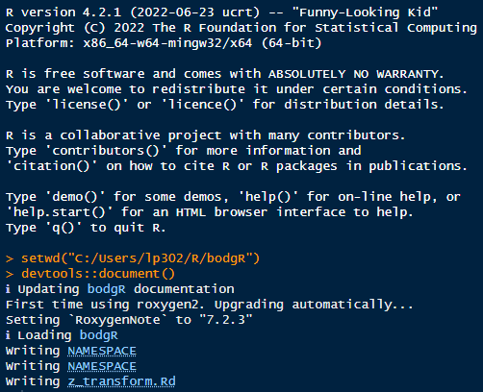
Now we run `devtools::document()` - which runs `roxygen2` nicely in the current working directory

Slide 16
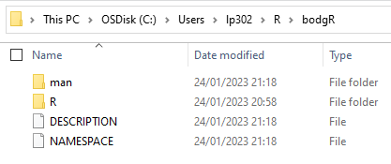
Package directory now contains all the required files
2 text files
A description of the package
The names of the functions included
2 directories
The actual R scripts
The associated ‘help’ packages for each function
Package
| DESCRIPTION
| NAMESPACE
|
└───R
| | script.R
|
└─── man
| | script.Rd

Slide 17
These files can be shared and installed
zip up the files:
bodgR.v0.1.0.zip
Then in R run:
devtools::install_local("/path/to/file/bodgR.v0.1.0.zip")

Slide 18
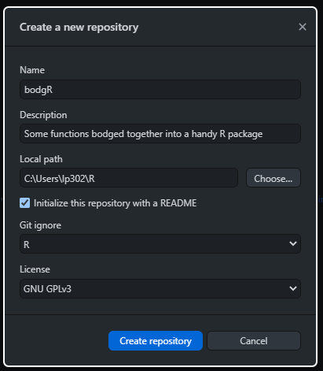
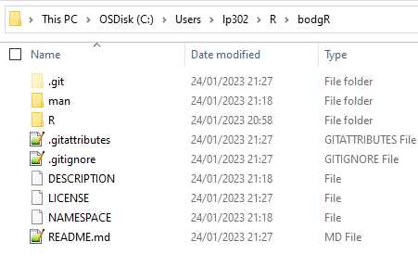
Making it accessible to others via GitHub
I use GitHub Desktop.
Create a new repository in the parent directory of your R package (make sure the names match)
And you get the .git related files

Slide 19
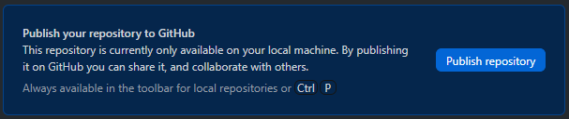
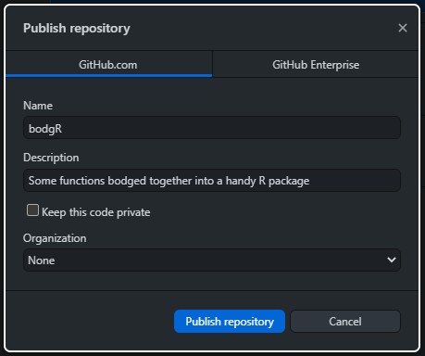
Making it accessible to others via GitHub
“Publish” repository via GitHub Desktop

Slide 20
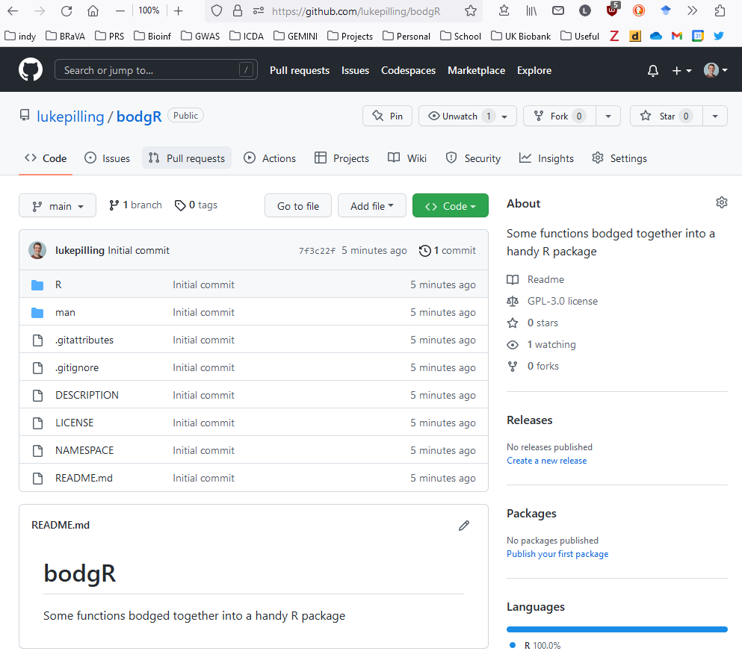
Making it accessible to others via GitHub

Slide 21
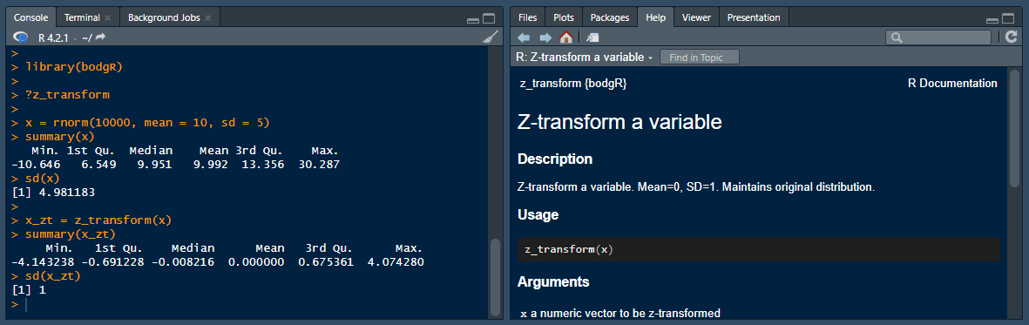
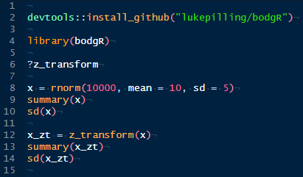
Making it accessible to others via GitHub

Slide 22
Lots of useful additions you can do
More functions!
Better “README” for the GitHub landing page (include tutorials etc?)
Write vignettes so more info/tutorials come with the package directly
Use `pkgdown` to create nice websites based on your package/vignettes
R packages by Hadley Wickham and Jenny Bryan. https://r-pkgs.org/

Slide 23
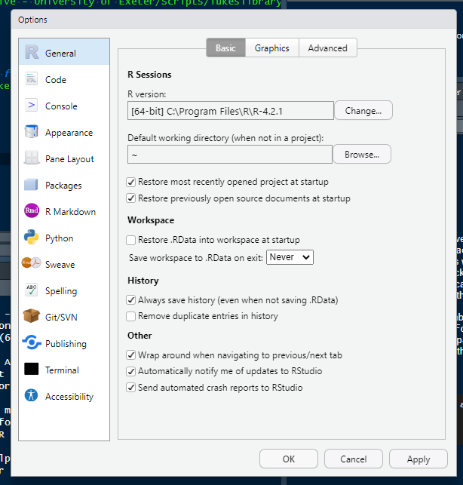
An aside… do your RStudio a favour
Uncheck
“Never”

